Slide 1

Data-simulation engine

Slide 2
Team of the project
Nappo Davide – 127838
Tarabelli Marco - 127839

Slide 3
Table of contents
01
02
03
04
05
06
Project Description
Architecture
Technology used
Key component of the code
Conclusion
Future improvements

Slide 4
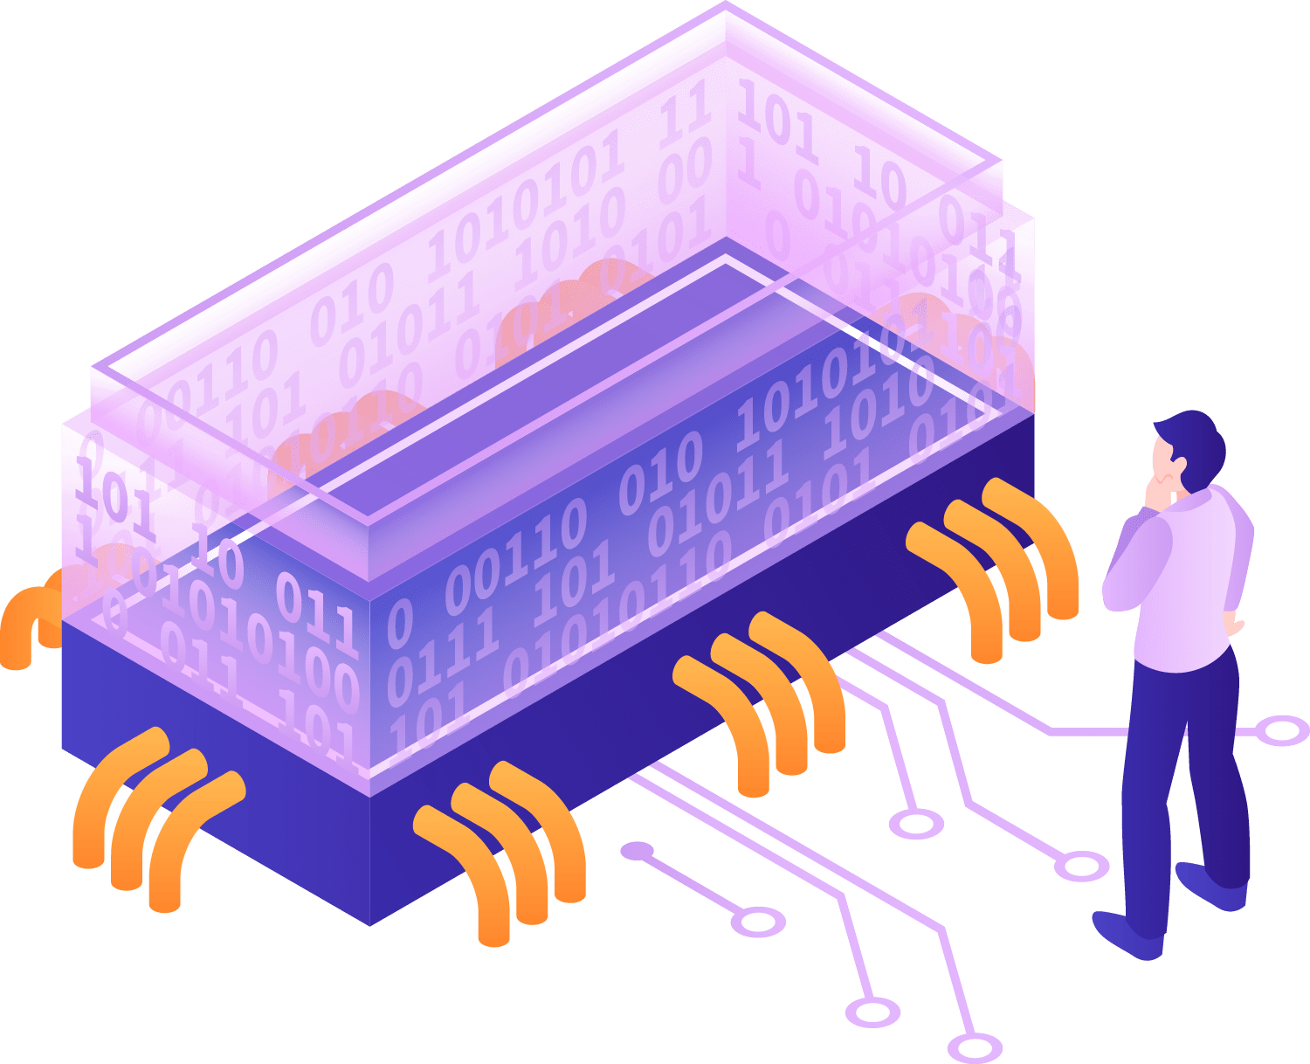
01
Project description

Slide 5

Project description
This project involves the development of a system to manage sensor data using Docker containers and message brokers like MQTT and Kafka. The goal is to simulate temperature sensors, both physical and Docker-based, and stream the data to MQTT broker for further processing. The system reads configuration files to control sensor behavior, such as frequency, temperature range, and iteration count. Two types of sensors are managed: temperature sensors that generate random data, and Docker sensors that use a container to collect the data.

Slide 6
02
Architecture

Slide 7
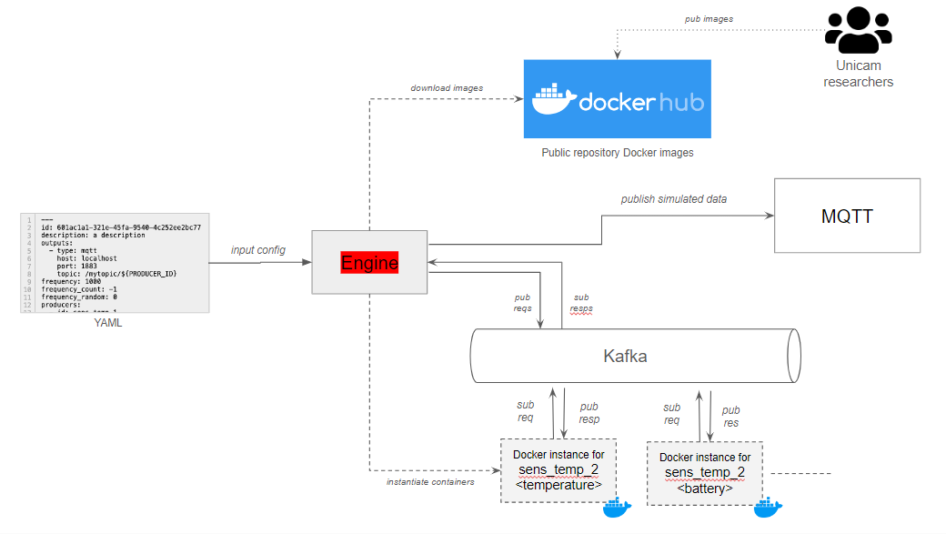
Architecture
Key Components:
YAML Configuration
Engine
Docker Hub
Kafka
MQTT

Slide 8
03
Technology used
PYTHON
KAFKA
MQTT
DOCKER

Slide 9

Docker
Containerization Technology
Docker Sensors
Resource Isolation
Scalability

Slide 10
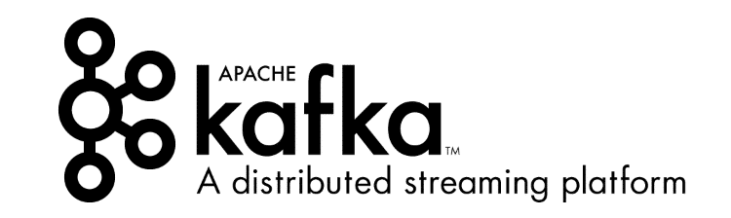
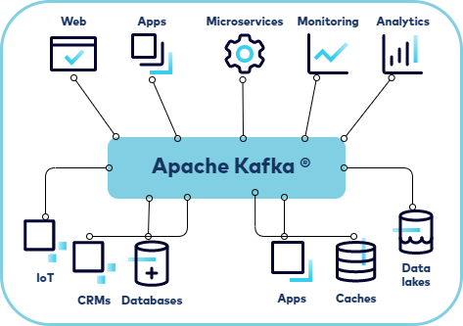
Kafka
Distributed Messaging System
Topic-based Communication
Fault Tolerance
Stream Processing

Slide 11
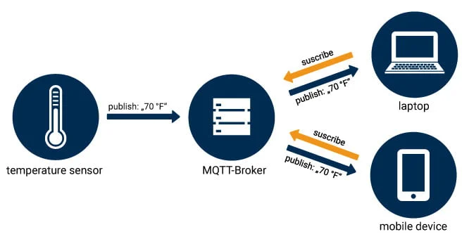
MQTT
Lightweight Protocol
Asynchronous Data Transfer
Broker-Based Architecture
Real-Time Data

Slide 12

Python
Primary Programming Language
Code Flexibility
Thread Management
Extensive Libraries

Slide 13
04
Key component of the code

Slide 14
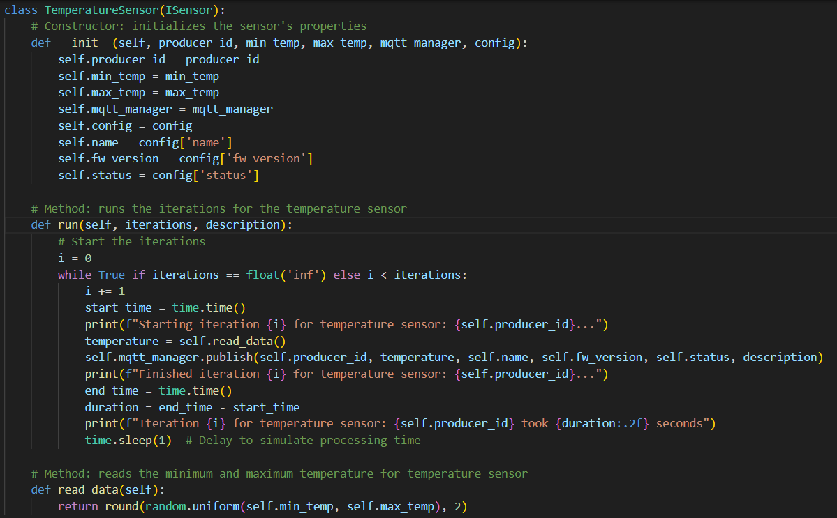
Temperature Sensor and Docker Sensor
TemperatureSensor:
Generates a random temperature between min_temp and max_temp.
DockerSensor:
Runs within a Docker container to simulate data
.

Slide 15
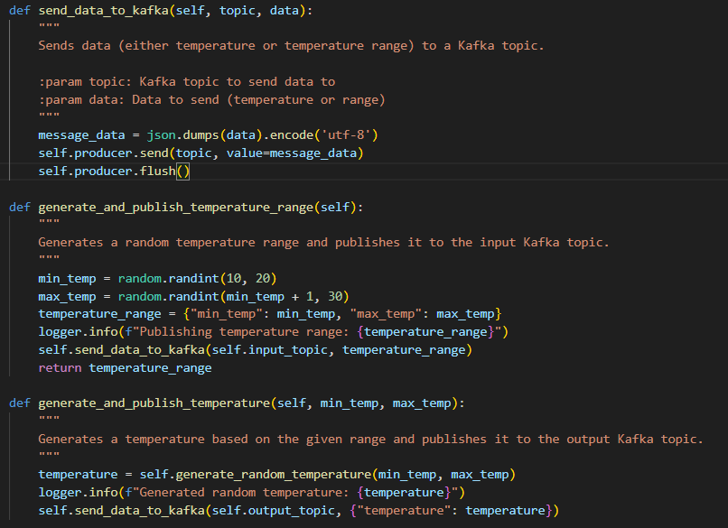
Docker Image

Slide 16

DockerManager and KafkaTemperatureConsumer
DockerManager:
Manages starting, stopping, and restarting of Docker containers.
Ensures that Docker containers remain running for the desired duration
KafkaTemperatureConsumer:
Listens for temperature data published to Kafka topics.
Processes the data

Slide 17
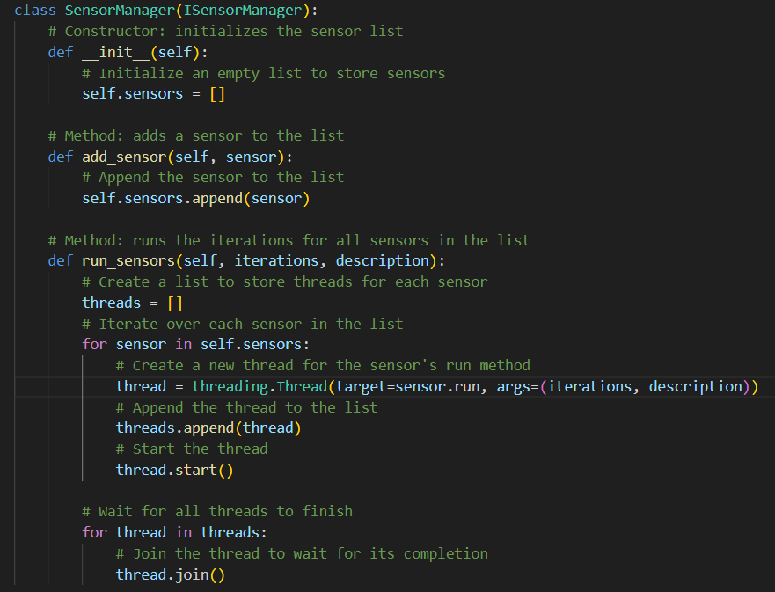
Thread Management
Purpose:
Ensures that sensors run concurrently
Avoids blocking operations
Implementation:
Each sensor is managed in a separate thread using Python's threading module.
Key Features:
Concurrent Execution
Thread Lifecycle
Benefits:
Enhances responsiveness of the system.
Allows for real-time data generation and collection from multiple sources.
Ensures scalability as new sensor types can be added easily without disrupting the existing workflow.

Slide 18
05
Conclusions

Slide 19




Conclusions
Overview of the Project:
Key Achievements:
Impact:
Implemented a robust architecture
Achieved seamless communication
Established a flexible configuration system
The project demonstrates a scalable solution for real-time data processing.
It lays the foundation for future developments and enhancements in sensor integration and data management.
Successfully developed a system to collect and process data in real time.
Utilized Docker, Kafka and a MQTT broker

Slide 20
06
Future improvements

Slide 21





Future improvements
Enhanced Scalability
Improved Error Handling
User Interface
Advanced Analytics
Testing

Slide 22

Thanks!

